Slide 1
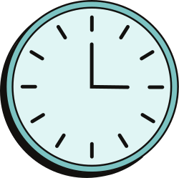




Hearing Aid for Mild Hearing Loss
Presenter:
Name: Abrar Mohi Shafee
Mat. Num: 25968

Slide 2


The Problem
The Solution
1. A hearing aid
2. I wrote a program that captures low-pitched sound through the mic and amplifies it.
3. Target group is mild hearing loss (20-40dB)
1. Many people in the world suffer from hearing loss a.k.a 'Hearing Impairment'
2. Hearing loss can be of different types (e.g. mild, moderate, severe, very severe)

Slide 3
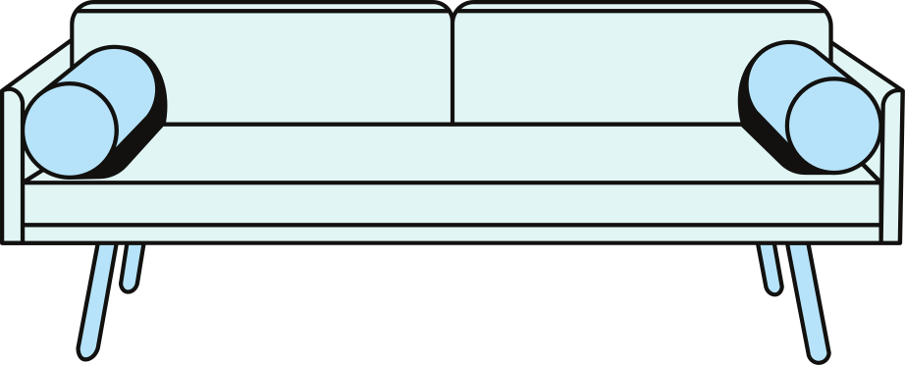
1. Microphone picks up the surrounding sound
How This Hearing Aid Works
2. Amplifier makes the sound louder
3. Receiver sends the amplified sound

Slide 4


Program Explanation Page 1
Screen Configuration
1
screen = get(0,'ScreenSize');
P1 = [50 300 screen(3)/2 screen(4)/2];
P2 = [620 80 screen(3)/2 screen(4)/2];
2
3
Microphone Parameters
4
samplesPerSecond = 1024;
framesPerSecond = 44100;
t = 30;
numPlays = (t*framesPerSecond) / samplesPerSecond;
5
6
7
Audio Recording
8
mic = audioDeviceReader;
mic.SamplesPerFrame = samplesPerSecond;
mic.SampleRate = framesPerSecond;
9
10

Slide 5
Program Explanation Page 2
Audio Playback
11
audioPlayer = audioDeviceWriter('SampleRate',framesPerSecond);
Scope Parameters
12
scope = dsp.TimeScope('SampleRate',framesPerSecond,'TimeSpan',0.1,... 'Position',P1,'YLimits',[-1 1]);
scope.ShowGrid = 1;
scope.ShowLegend = 1;
13
14
15
Spectrum Analyzer
16
graph = dsp.SpectrumAnalyzer('SampleRate',framesPerSecond,'Position',P2,... 'PlotAsTwoSidedSpectrum',false);
graph.SpectrumType = 'Spectrogram';
17
18

Slide 6
Program Explanation Page 3
Stream Loop
19
while numPlays>0
data = step(mic);
step(audioPlayer, double(data));
step(scope,data);
step(graph,data);
numPlays = numPlays-1;
end
20
21
22
23
24
25
Release Hardware
26
release(mic);
release(audioPlayer);
release(scope);
release(graph);
27
28
29

Slide 7
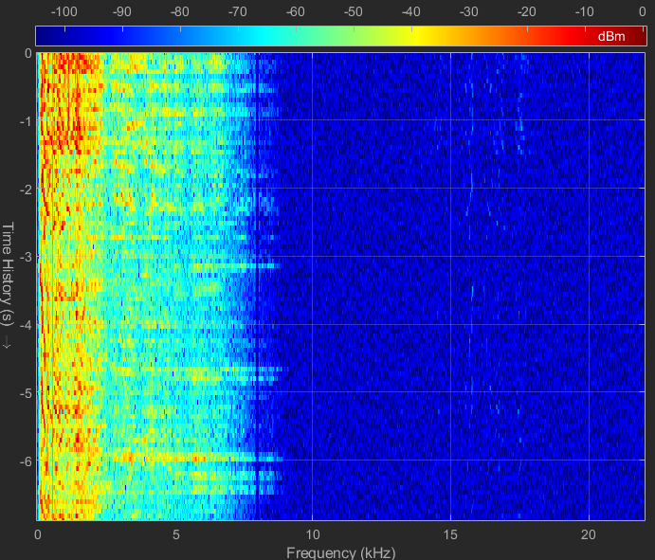
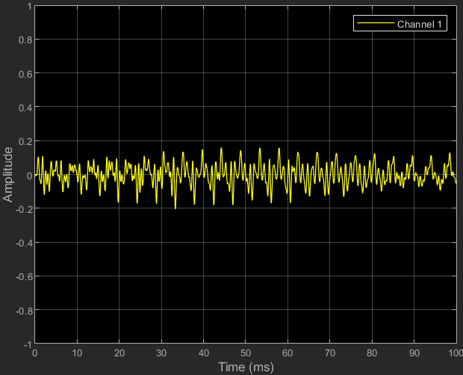
The amplified sound is played back in real time
The Result
Time Scope
Spectrum Analyzer

Slide 8


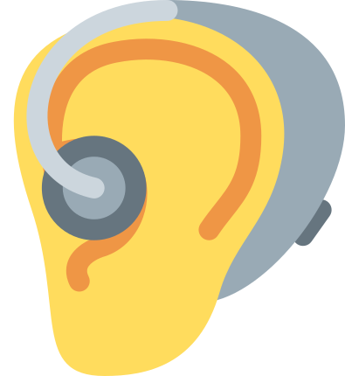

Project source code can be found on:
https://github.com/abrarmohi/hearing-aid

Slide 9
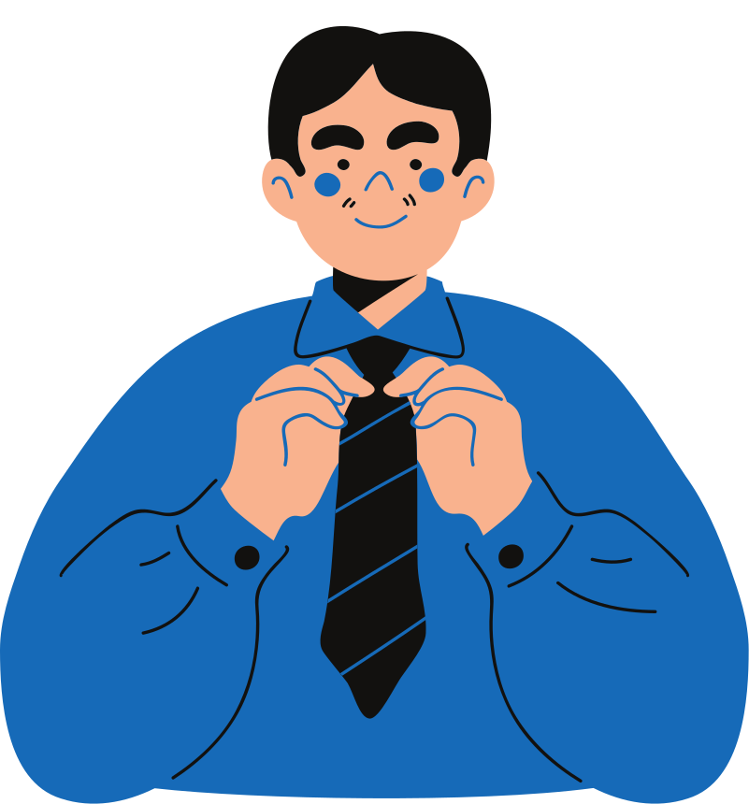

References
Hearing Loss - https://en.wikipedia.org/wiki/Hearing_loss
Hearing Aid Basics - https://www.webmd.com/healthy-aging/hearing-aids#1
Simple Hearing Aid - https://de.mathworks.com/matlabcentral/fileexchange/50905-simple-hearing-aid

